Slide 1
INT222
COURSE INFORMATION, Short JavaScript / Scratchpad Introduction

Slide 2
Welcome! – Course Information
From the course outline:
This course introduces students to Internet architecture and software development principles, using the World Wide Web as the system example. After successfully completing the course, a student will be able to design and create web pages for web browsers, while applying knowledge of HTML5 technologies.
Students begin by learning JavaScript, the programming language of the Web. Then, the Document Object Model (DOM) is studied, and with it, documents that use the Hypertext Markup Language (HTML) to define its structure and content. To affect and modify the appearance and formatting of a document, students learn and apply the foundations of the Cascading Style Sheet (CSS) language. Throughout this progression of topics, JavaScript is continually used to access and modify the content and appearance of documents through the DOM interface.

Slide 3
Course Information – Format
4 hours / week (2 hours lecture, 2 hours workshop [lab]
NOTE: You are encouraged to attend all workshops periods as they may contain additional lecture material, help with assignments, labs, etc.
Grading
6 Labs (5% /ea - 30% total)
7 Quizzes (5% /ea – 35% total)
1 Term Test (15% total )
1 Final Exam (20% Total)

Slide 4
Course Information
INT222 Website walkthrough covering:
Course Timeline and Weekly Objectives
Course Standards
My.Seneca walkthrough covering:
Announcements
Course Information
Course Documents
Labs
Grades

Slide 5
Course Information / Textbook
No text book.
We will be going by the lecture slides posted under “Course Documents” on My.Seneca. There are currently no lectures posted there, but the night before each lecture class, I will upload the slides.
Reference material:
Links available on the course website under “Resources”: https://scs.senecac.on.ca/~patrick.crawford/#/fall-2016/int222?tab=resources

Slide 6
Labs
You will find the labs under the “Labs” section of My.Seneca on the day they are released (typically the day of your lecture)
You will know that a new lab will be available in an upcoming week by checking out the schedule
Labs will usually cover material from the weekly lectures
Labs are meant to reinforce the lecture material, though new material may be introduced
The quizzes, test and exam will cover Lab material as well as lecture material

Slide 7
Labs – Grading Policy
There is a zero late policy on Labs.
If the Lab is late, it will be given a grade of zero, so pay close attention to the due dates.

Slide 8
Tests – Grading Policy
There will be one (1) Term test - worth 15% in total
The Term test will be held during week 8 of the lecture period
If you miss writing a test - See the “Term Tests & Quizzes” in the standards section
Questions on the Term test will be on material covered in class from the start of the semester as well as material from Labs

Slide 9
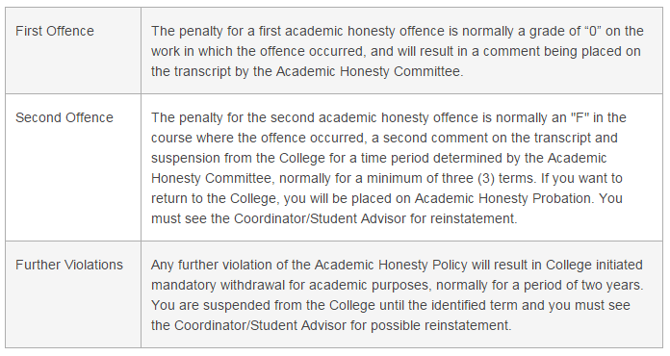
Cheating and Plagiarism
To support academic honesty at Seneca College, all work submitted by students may be reviewed for authenticity and originality, utilizing software tools and third party services. Please visit the Academic Honesty site on http://www.senecacollege.ca/academic-policy/index.html for further information regarding cheating and plagiarism policies and procedures.

Slide 10
In Order to Pass
To obtain a credit in this subject, you must:
Achieve an average of 50% or better for all labs
Achieve an average of 50% or better for all quizzes
Achieve a grade of 50% or better on the final exam
Achieve weighted average of 50% or better on all assessments

Slide 11
Web Client Programming
Web development is a broad term for the work involved in developing a web site for the World Wide Web. The INT222 course deals strictly with the client side of the web development.
This course covers three parts of this development
JavaScript (JS) Allows client-side scripts to interact with the user
HyperText Markup Language (HTML5) The main language for creating web pages
Cascading Style Sheets (CSS) Used for describing the look and formatting of a web page

Slide 12
Web Client Programming – Tools
Developer tools
All modern web browsers come with built in development tools – these can be accessed by pressing “F12”
HTML Validation
W3C HTML Validation Service Check the HTML, HTML5, .. of Web documents
Link Checker Check links and anchors in Web pages or full Web sites
Living Validator Check the html5 of Web documents
JavaScript Scratchpad - part of Firefox (Tools -> Web Developer -> Scratchpad) To activate - Shift + F4 To Run - Ctrl + R
Online JavaScript Lint (http://www.javascriptlint.com/online_lint.php)
CSS Basics (http://csstypeset.com/)
HTML / Javascript online environment (http://jsfiddle.net/)
See the “Resources” section on the course Website

Slide 13
Great – How do I get started?
Why don’t we do a short example?
Open up the Firefox web browser
Open the Console by pressing F12 (Windows)
Make sure that JS is selected:
Open Scratchpad by pressing Shift + F4

Slide 14
Getting Started – Cont’d
In the Scratchpad window, type the following:
Click the “Run” button and see what appears in the console.
Change your code to read:
Run the code again
console.log("Hello World!");
var myTeacher = "Pat";
console.log(myTeacher);

Slide 15
Getting Started – Cont’d
Why don't we introduce an error to see what happens?:
Change your code to read:
Run the code again
Notice that Scratchpad shows an exception: SyntaxError: missing ) after argument list
Fix the error and run your code again
Save the Code to your desktop as "Ex1.js" using the "Save As" button
var myTeacher = "Pat";
console.log(myTeacher

Slide 16
Getting Started – Cont’d
Close the Browser
Open it again and make sure the JS console is visible
Open the Scratchpad
Open your "Ex1.js" file using the "Open File…" button
Run your code to make sure it works correctly.

Slide 17
Congratulations
You have successfully created and saved your first JavaScript code example!
This is how we will be working with JavaScript for the first part of INT222.
Going forward, you will submit your Lab work (.js files) to Blackboard under "Labs"

Slide 18
Questions?
Any questions about the course (ie: material covered, test / assignment policies, references, technology, etc?)

